Slide 1
Large Deflection of Shell

Slide 2
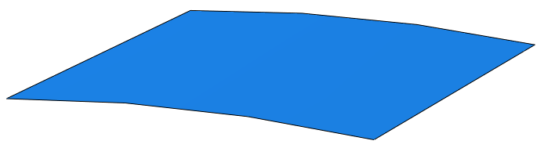
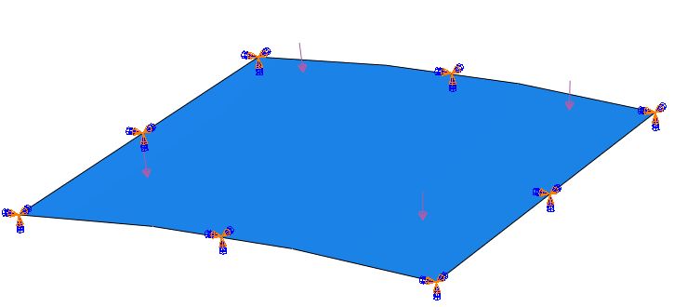
Problem Set-Up
20 in
2 Loads Applied:
P = 0.08 lb/in^2
P = 0.16 lb/in^2
20 in
R100 in
Material Info:
t = 0.125 in
E =450000 lb/in^2
v = 0.30
Shell clamped on all edges

Slide 3
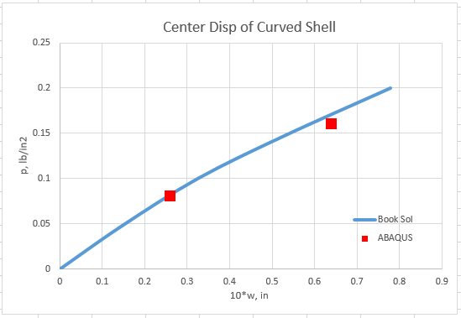
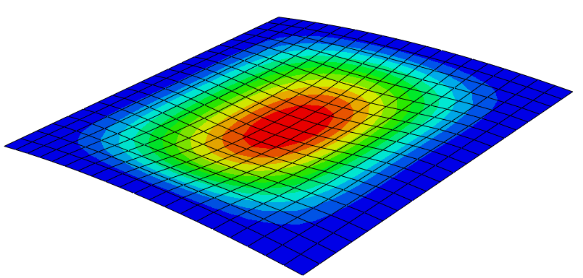
Results
1
2
P = 0.08 lb/in^2
P = 0.16 lb/in^2

Slide 4
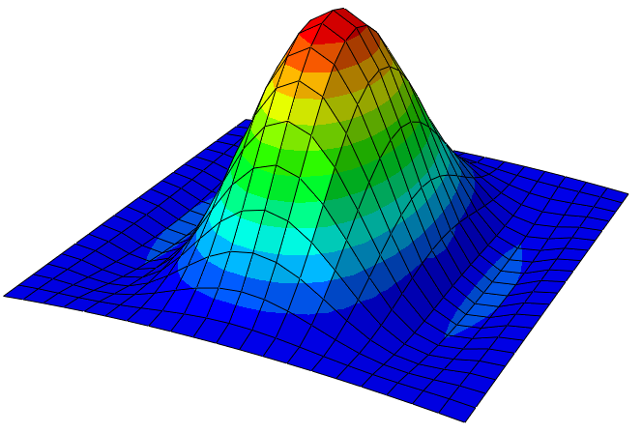
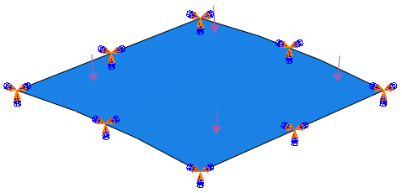
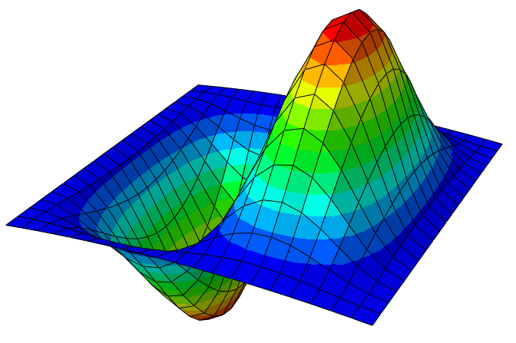
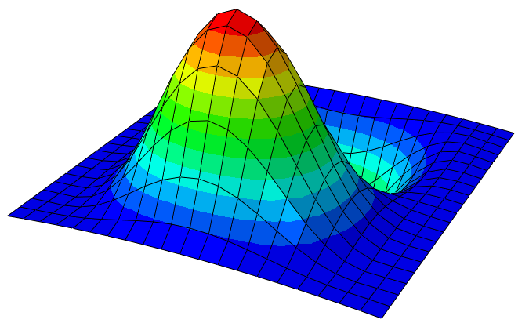
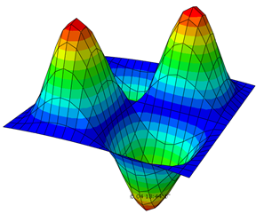
Results (Frequency)
Load applied to generate preload
P = 0.10 lb/in^2
Mode 1
Mode 2
Mode 3
Mode 4
 | Free Response | Preloaded Response w/o Large Disp. | Preloaded Response w/t Large Disp.
1 | 2.8 | 2.8 | 2.2
2 | 3.1 | 3.1 | 2.6
3 | 3.9 | 3.9 | 3.6
4 | 4.2 | 4.2 | 3.8

